Slide 1
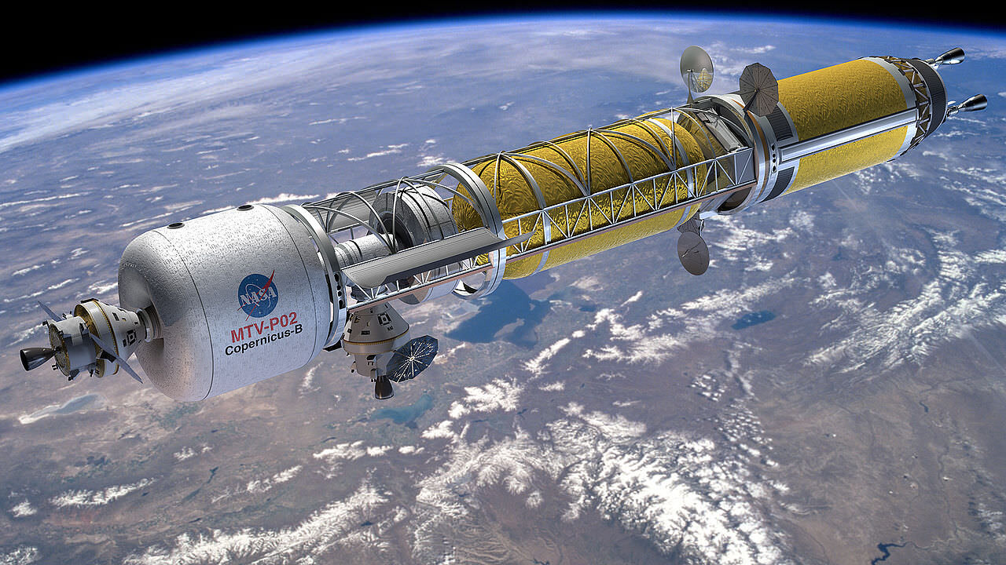
Team 514: Hydrogen Pre-Heater in the Nuclear Thermal Rocket Simulation
Michael Corak
Kevin Hartzog
Jordan Weid
Notes:
https://www.asme.org/topics-resources/content/the-future-of-nuclear-rockets-for-space-travel

Slide 2
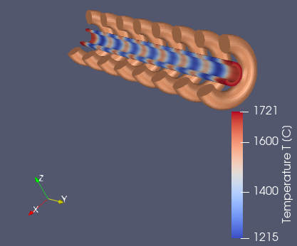
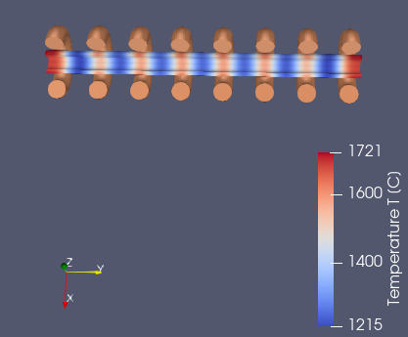
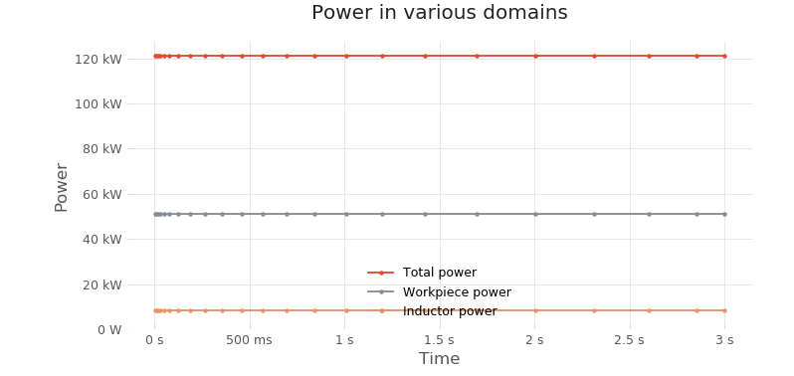
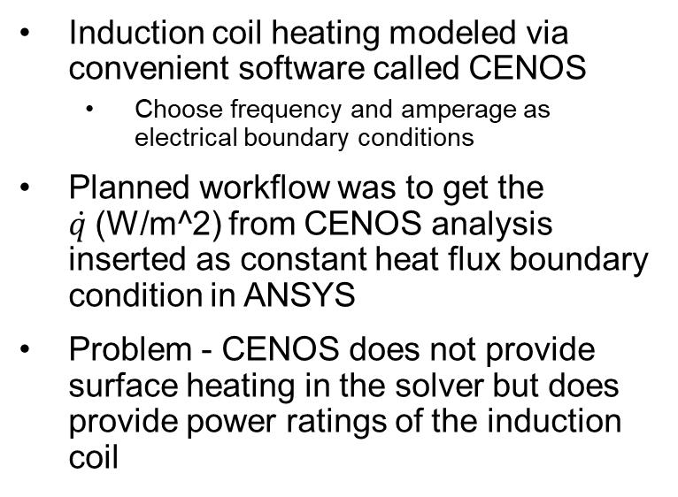
Past Work
Induction coil heating modeled via convenient software called CENOS
  Choose frequency and amperage as electrical boundary conditions
Planned workflow was to get the $\dot{q }$(W/m^2) from CENOS analysis inserted as constant heat flux boundary condition in ANSYS
Problem - CENOS does not provide surface heating in the solver but does provide power ratings of the induction coil

Slide 3
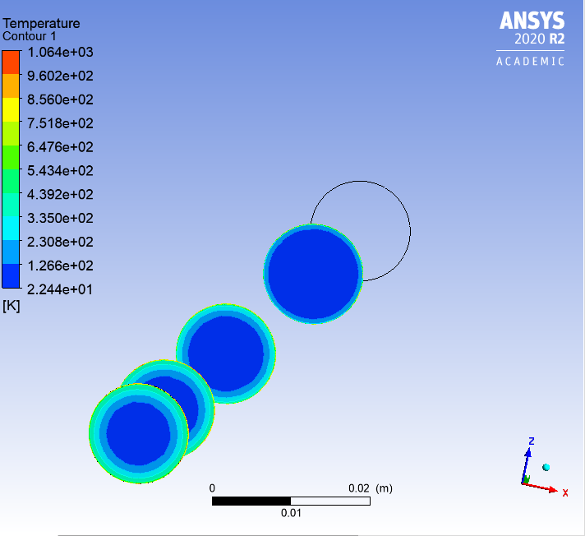
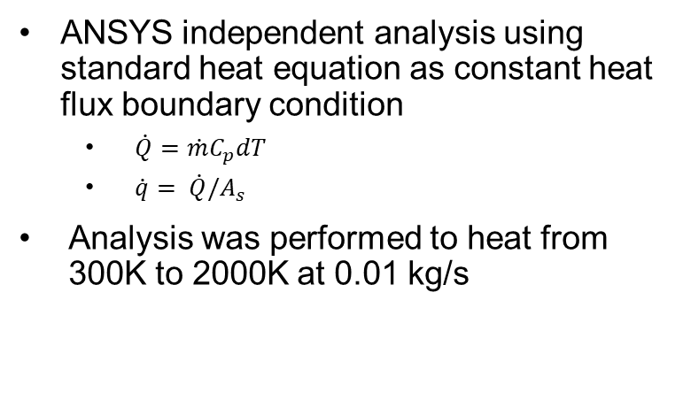

Past Work
ANSYS independent analysis using standard heat equation as constant heat flux boundary condition
  $\dot{Q}=\dot{m}C_{p}dT$
  $\dot{q}= \dot{Q}/A_{s}$
Analysis was performed to heat from 300K to 2000K at 0.01 kg/s
$$πDL$$
Temperature Distribution for 10-inch-long cylindrical heat exchanger
Notes:
Note the independent part means the flux was found from the Energy equation not from CENOS

Slide 4
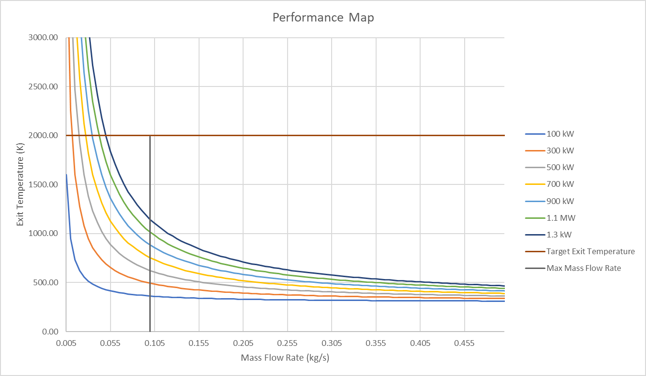
Adjusted Scope
Provide a tool to select pre-heater power levels for different operating conditions like mass flow rate and temperature rise
Investigate simple cylindrical heat exchanger and conduct heat transfer analysis
Simple Cylindrical Heat Exchanger
Notes:
New main interpreted customer need is a tool
Discuss the two operating lines
Include that new operating requirements are less stringent and are more of a reference
Main point is that the scope is not a complete set in stone design but more groundwork for future

Slide 5
Adjusted Scope
Removed induction coil design and modeling from scope
Investigate alternative heat exchanger shapes and sizes
Notes:
New main interpreted customer need is a tool
Include that new operating requirements are less stringent and are more of a reference
Talk about beginning with simpler design and move to complex if results are insufficient

Slide 6
Future Work
Construct complete heat transfer analysis for simple cylindrical heat exchanger that incorporates geometric properties
Provide preliminary design recommendations to sponsor for simple cylindrical heat exchanger
Talk to induction coil manufacturer, Fluxtrol, about how a typical coil design works for a client in order to comment on design recommendations for future
Notes:
Simple geometries first then look into creating more abstract geometries with CAD
The key here is this will take longer as equations must be solved iteratively and requires finite element software

Slide 7
Project Background
T4
T3
Temperature (K)
Motivation - simulate the conditions found at any length of test article
T2
T1
Distance (in)
50 inches
Standard Uranium core size
20 inches
NTREES test article size
Jordan Weid

Slide 8
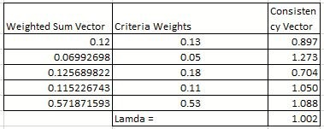

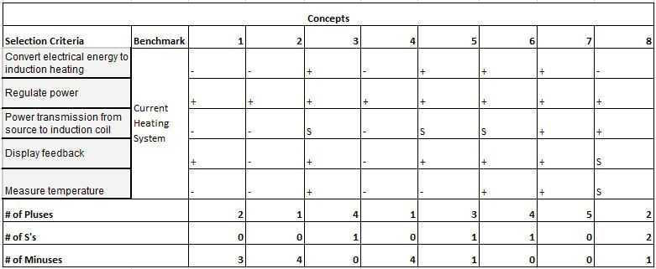
Appendix B : Concept Generation and Selection
AHP

